Slide 1
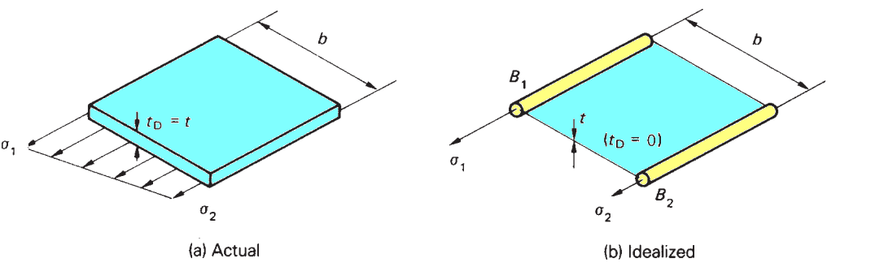
20.2 Idealization of a panel
Suppose that we wish to idealize the panel of Fig. 20.3(a) into a combination of direct stress carrying booms and shear stress only carrying skin as shown in Fig. 20.3(b). In Fig. 20.3(a) the direct stress carrying thickness t_{D} of the skin is equal to its actual thickness t while in Fig. 20.3(b) t_{D} = 0. Suppose also that the direct stress distribution in the actual panel varies linearly from an unknown value σ₁ to an unknown value σ₂.

Slide 2
Idealization of a panel
The analysis should predict the extremes of stress σ₁ and σ₂ although the distribution of direct stress is obviously lost. Since the loading producing the direct stresses in the actual and idealized panels must be the same, we can equate moments to obtain expressions for the boom areas B₁ and B₂.

Slide 3



Idealization of a panel
Taking moments about the right-hand edge of each panel
Similarly
In Eqs (20.1) and (20.2) the ratio of σ₁ to σ₂ , if not known, may frequently be assumed.
For axial load only σ₁/σ₂ = 1 and B₁ = B₂ = t_{D}b/2;
for a pure bending moment σ₁/σ₂ = −1 and B₁ = B₂ = t_{D}b/6.

Slide 4
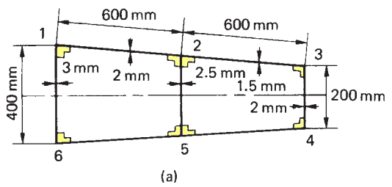
Idealization of a panel
Example 20.1
Part of a wing section is in the form of the two-cell box shown in Fig. 20.4(a) in which the vertical spars are connected to the wing skin through angle sections all having a cross-sectional area of 300mm². Idealize the section into an arrangement of direct stress carrying booms and shear stress only carrying panels suitable for resisting bending moments in a vertical plane. Position the booms at the spar/skin junctions.

Slide 5
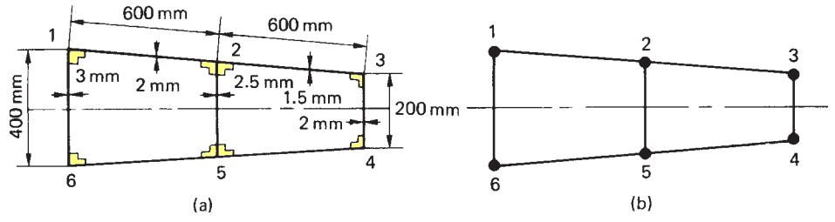
Idealization of a panel
Solution
The idealized section is shown in Fig. 20.4(b) in which, from symmetry, B₁ = B₆,
B₂ = B₅, B₃ = B₄. Since the section is required to resist bending moments in a vertical plane, the direct stress at any point in the actual wing section is directly proportional to its distance from the horizontal axis of symmetry. Further, the distribution of direct stress in all the panels will be linear so that either of Eqs (20.1) or (20.2) may be used.

Slide 6
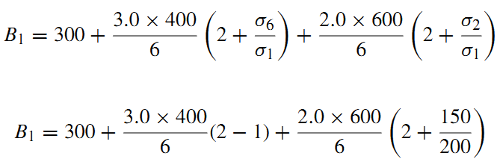

Idealization of a panel

Slide 7

Idealization of a panel

Slide 8



Idealization of a panel

Slide 9
Idealization of a panel
Generally, in any idealization, different loading conditions require different idealizations of the same structure.
In Example 20.1, the loading is applied in a vertical plane. If, however, the loading had been applied in a horizontal plane, the assumed stress distribution in the panels of the section would have been different, resulting in different values of boom area.

